Slide 1
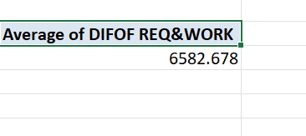
TASK 1
The Average lead time between the request date and the completion date for all the work orders are 6582.678. Some people finished their work prior and some people finished after the stipulated time.

Slide 2
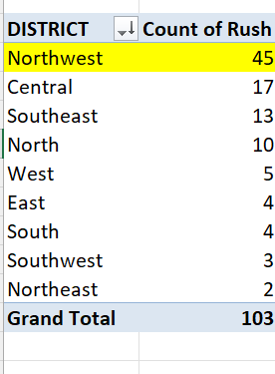
TASK 2
INFERENCE:
Northwest is having the highest no.of rush. So the work load is higher in that district .Central occupies the second most among them.

Slide 3
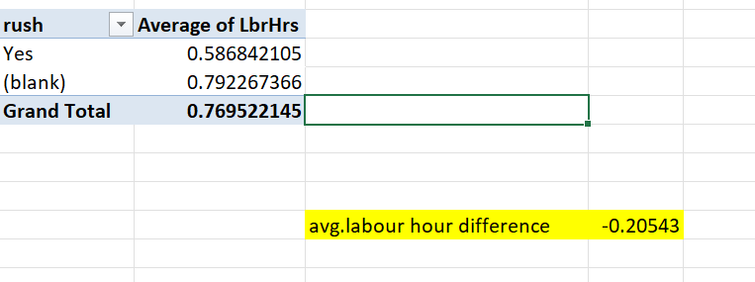
TASK 3
Average labour hours for people coming under rush category is 0.58 .
For non- rush people is 0.79. So the average difference is 0.20( negative non-rush ppl taken some time to finish their works compared to rushed ones).

Slide 4
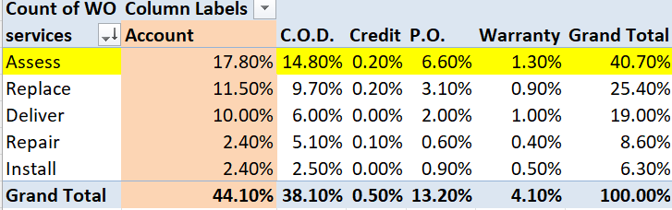
Task 4
INFERENCE:
Services across different payments .
From the analysis Assess service is having the highest distribution in payment methods. And also account payment having the highest percentages in all the services.

Slide 5
Distribution of payment types across different services

Slide 6
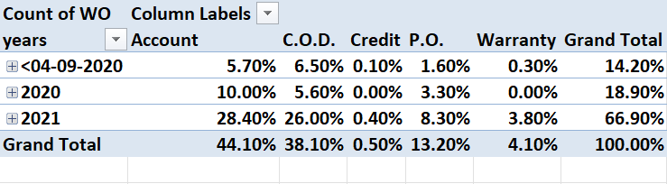
Task 5

Slide 7
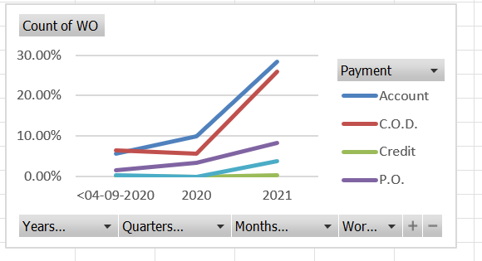
Task 5
INFERENCE:
Trends in the past years. Compared to previous years(before 2020).
The trends were increasing YOY in all the payments types.
They were improving the payment services year over year.

Slide 8

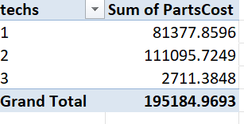
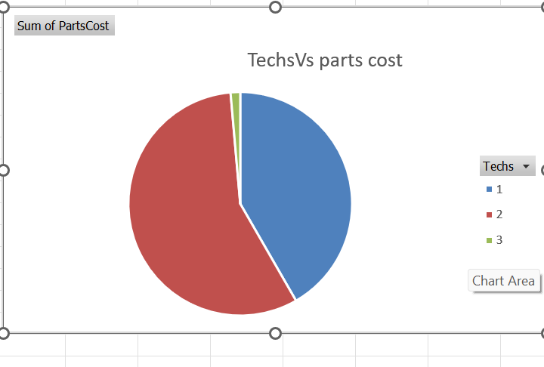
Task 6
INFERENCE:
There is a little bit of correlation between techs and the parts cost.
Correlation is 24%.
If parts cost was high, then it need to be carefully operated by the persons who knows this very well.
So techs came into picture. So, there is a relation when there is an increase in cost, there should be little increase in techs level.

Slide 9
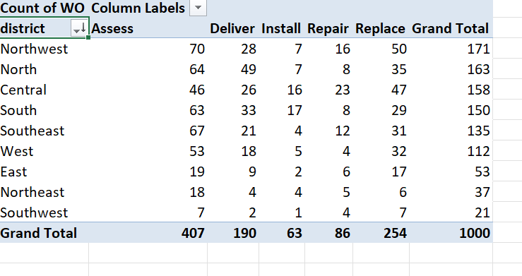
Task 7
INFERENCE:
Most common type of service requested in each district is assess.(171).
Assess is one of the important service that every employee or company needed.

Slide 10
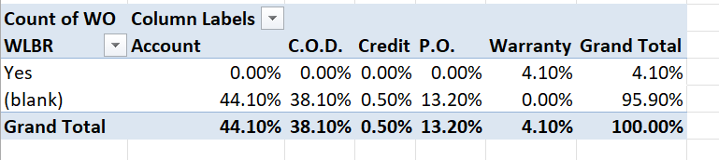
TASK 8
INFERENCE:
Persons who are all without the warranty is having the highest distribution across payment types.

Slide 11
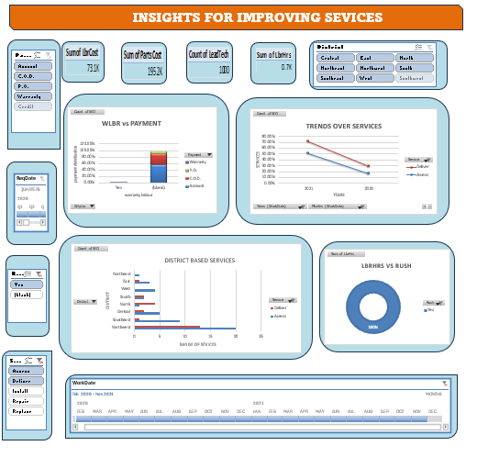
Task 9:
DASHBOARD:

Slide 12
